Slide 1
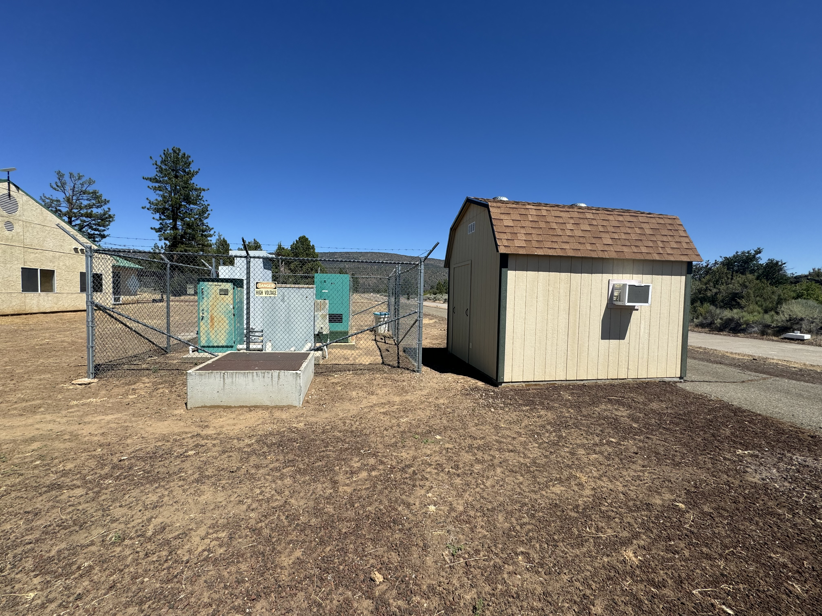
UPS shed
480V supply panel
old transformer
new concrete pad

Slide 2
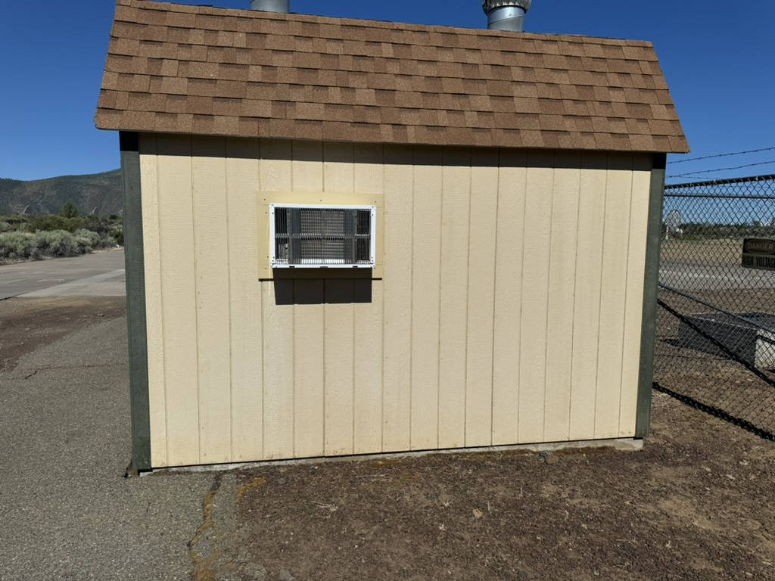
new concrete pad

Slide 3
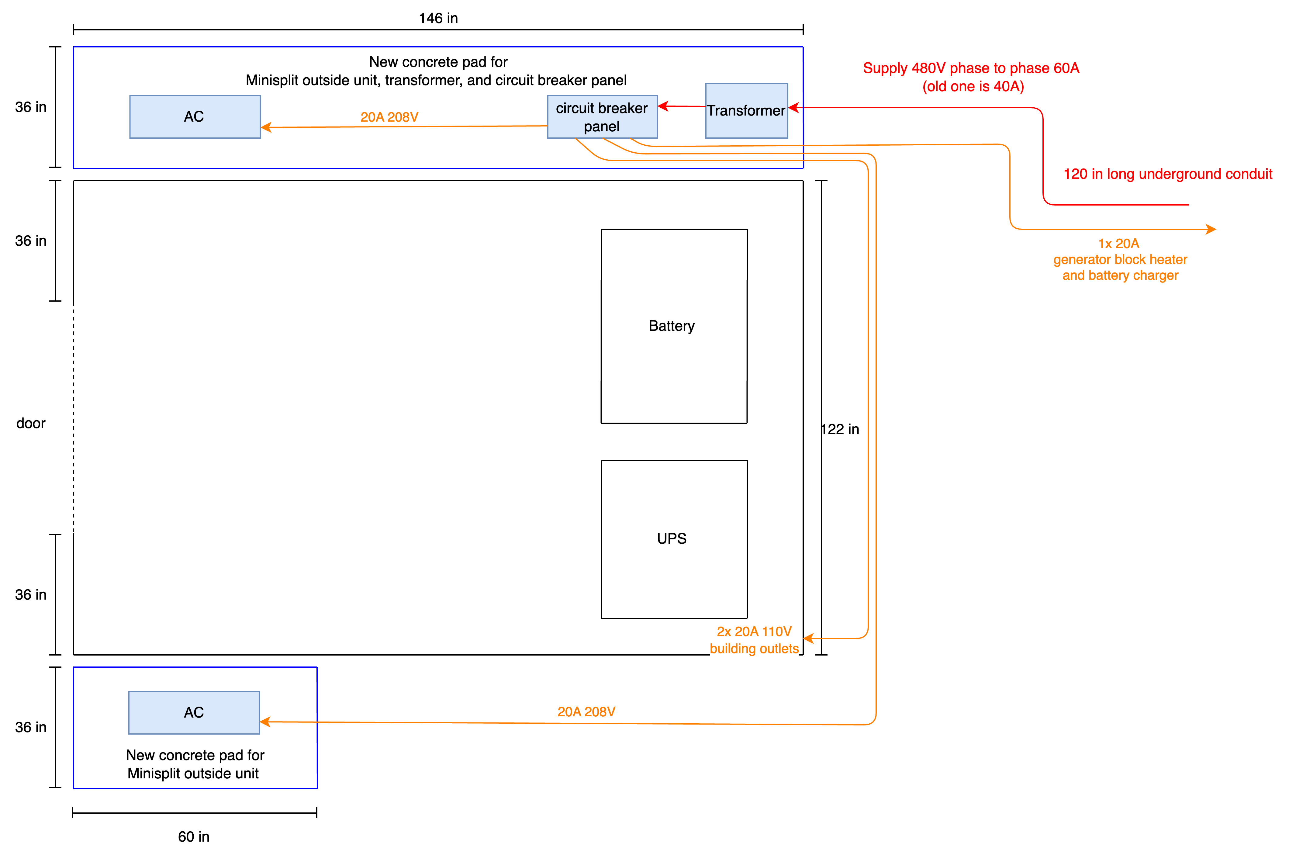

Slide 4
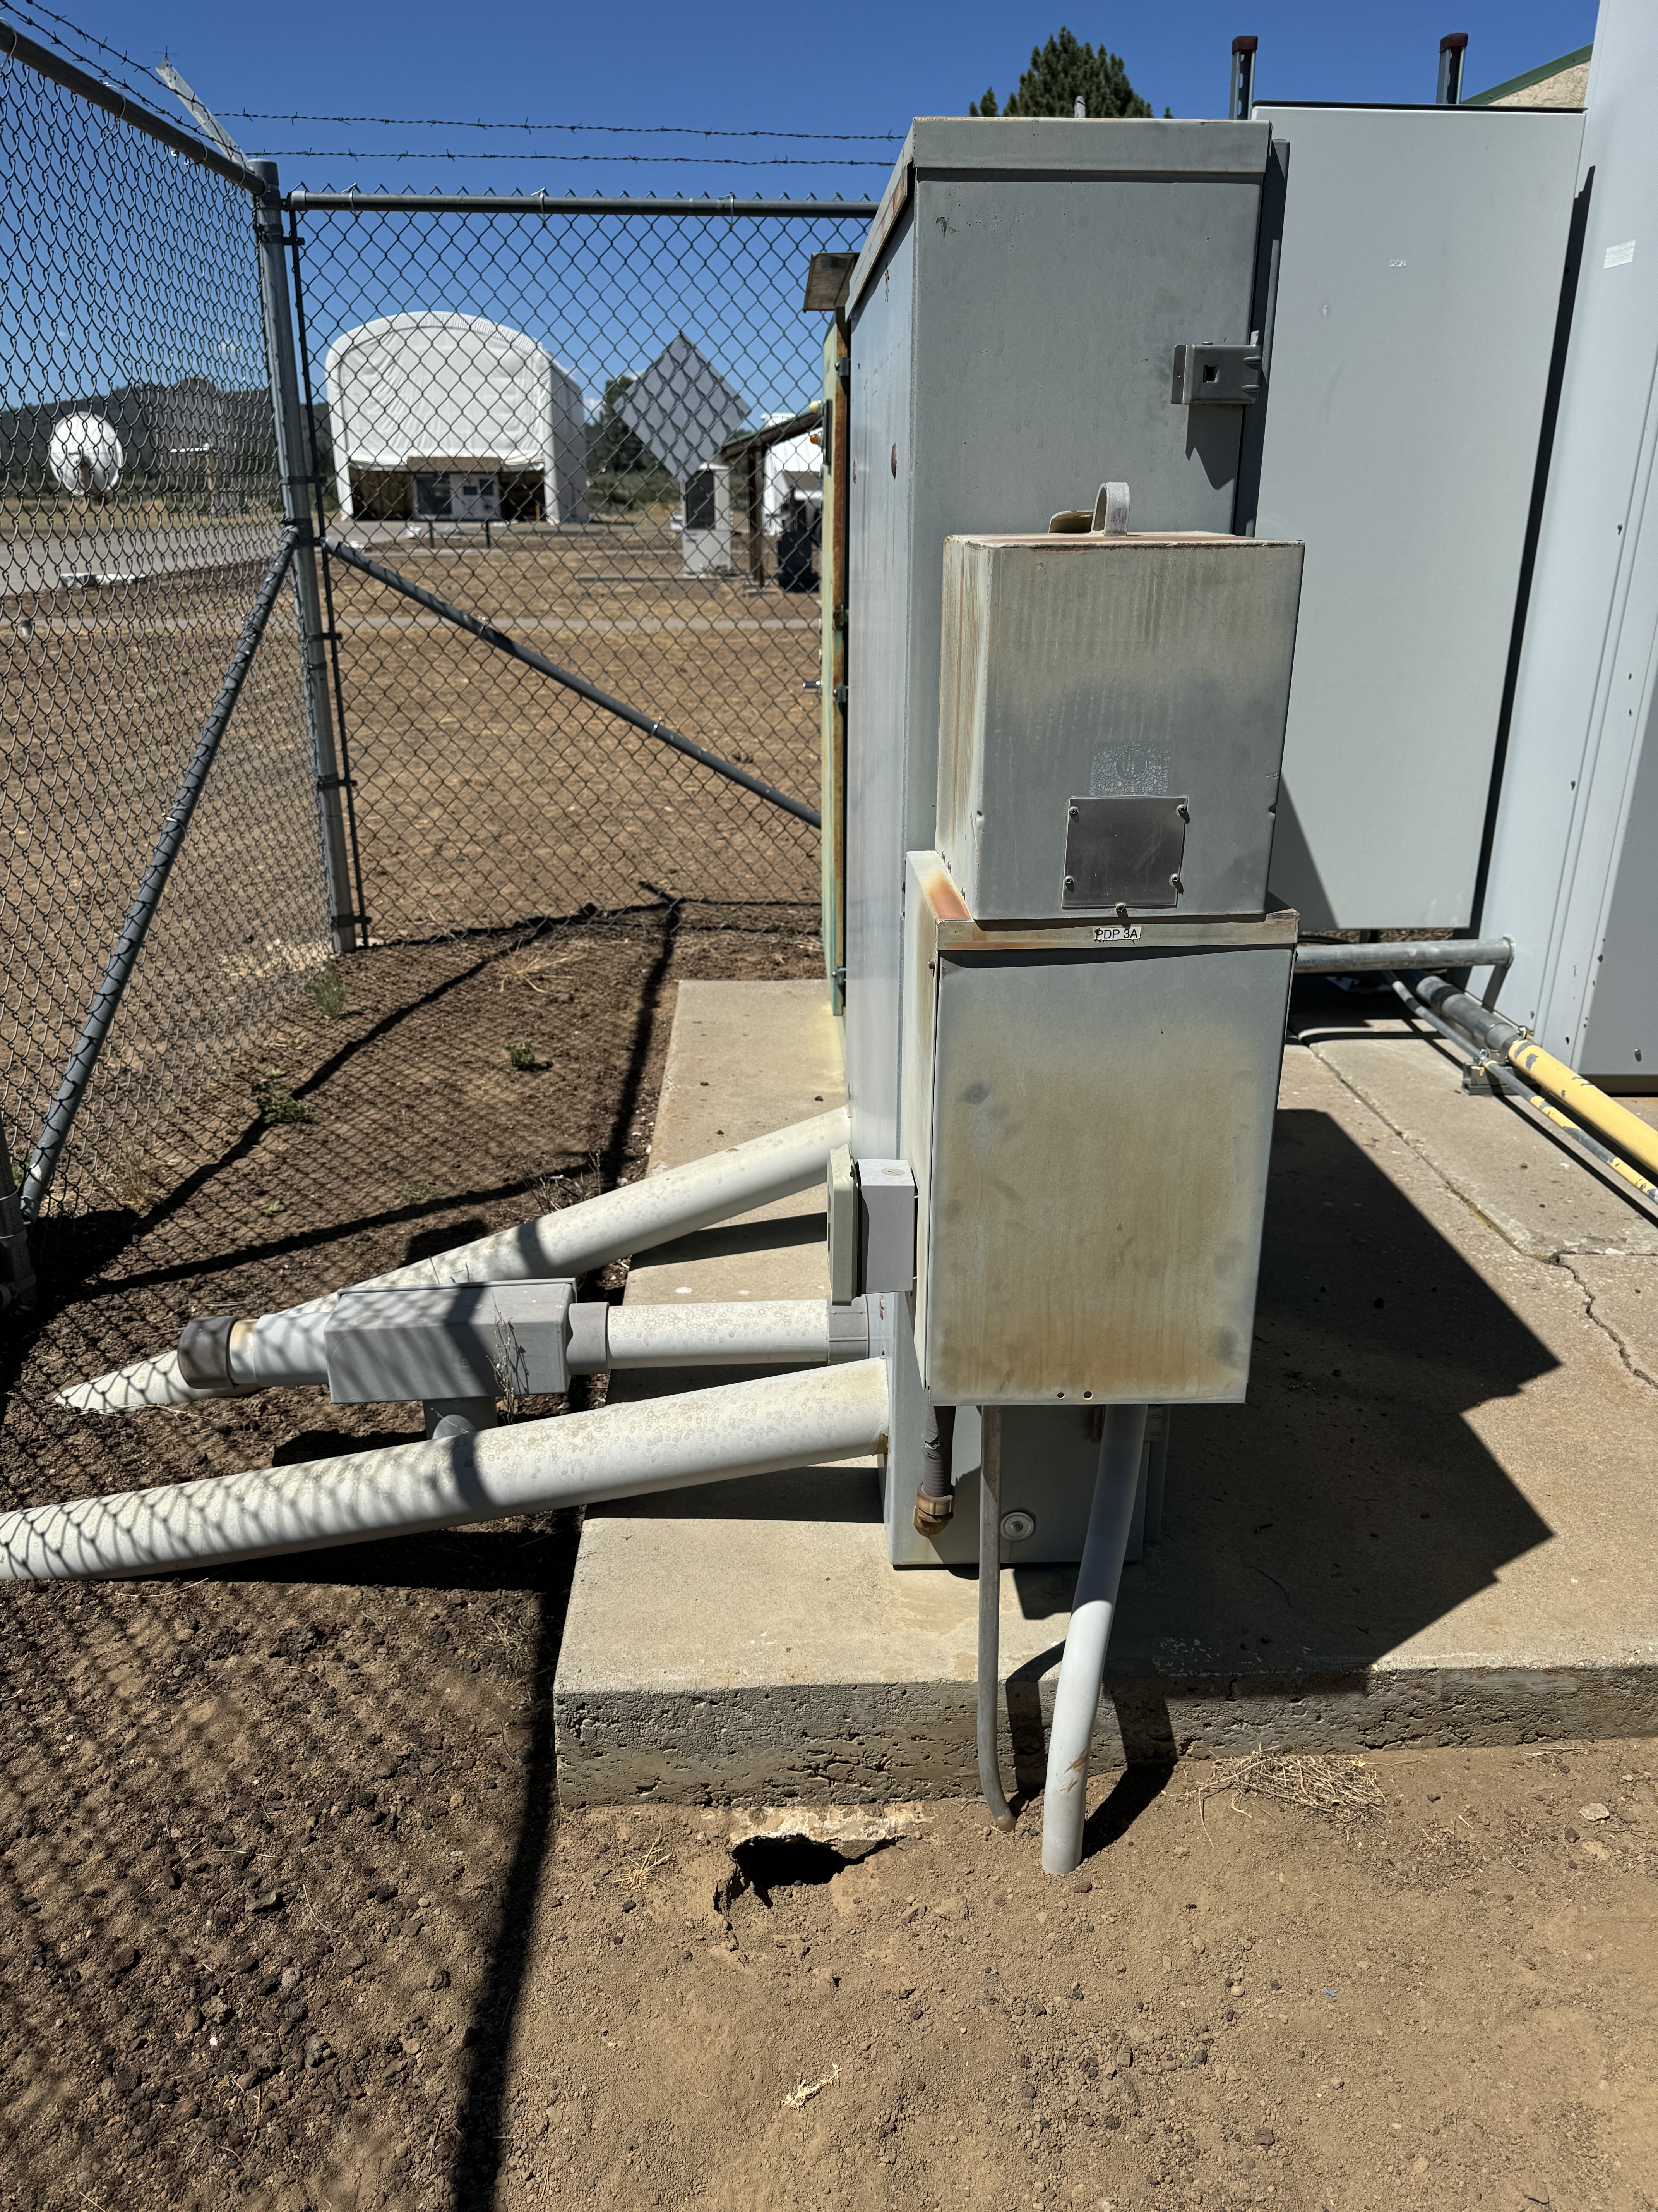
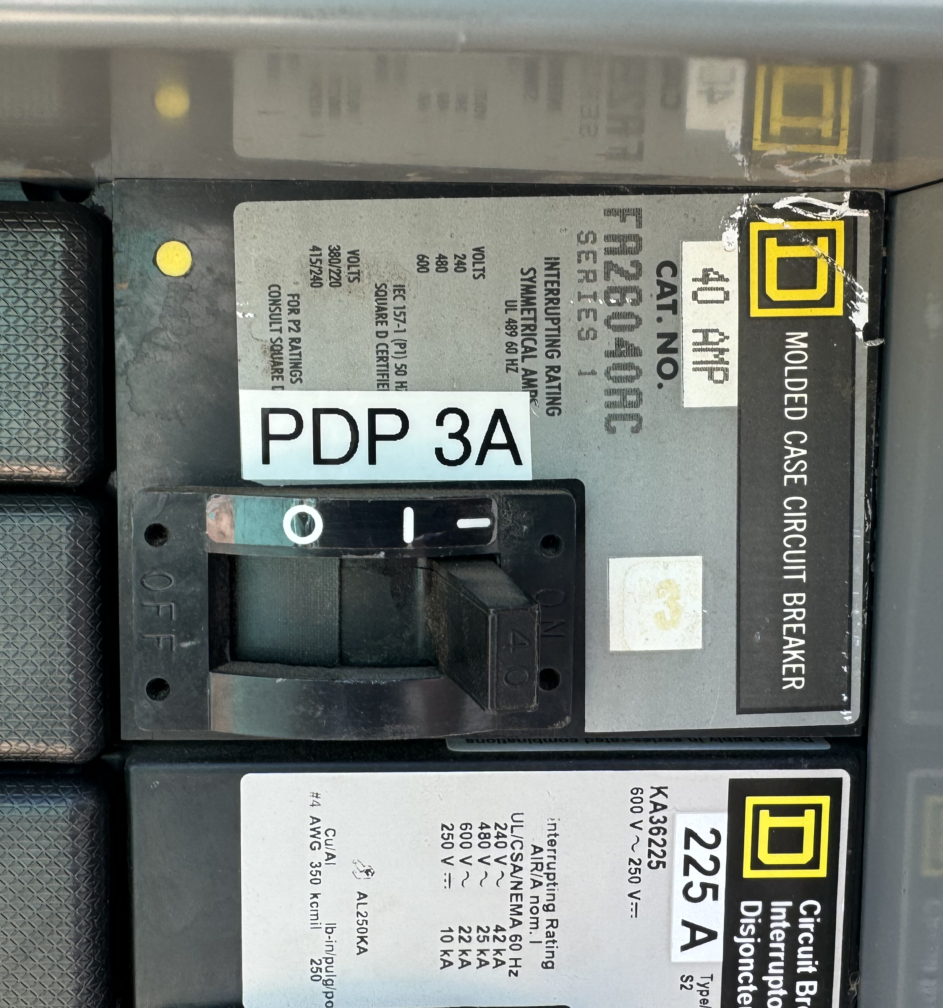
Supply panel PDP-3
breaker for transformer
480V supply panel
old transformer

Slide 5
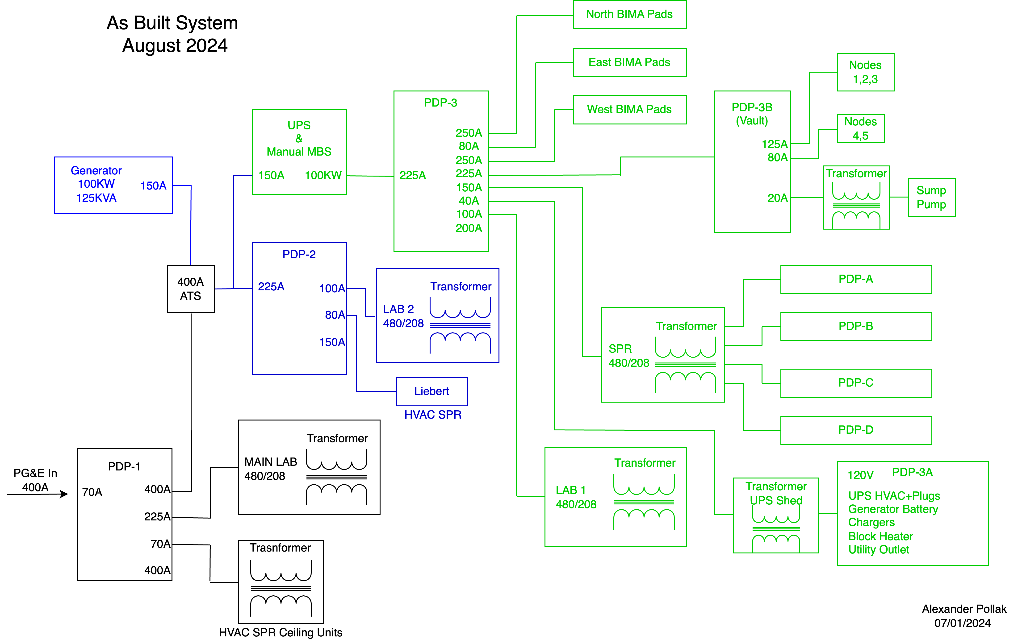
HCRO main power distribution
old transformer

